Slide 1
What is Research Impact?
Presenter
Helda Tutunchi
Assistant Professor of Nutritional Sciences (PhD)
Tabriz University of Medical Sciences

Slide 2
Integrative approaches

Slide 3
What is Research Impact?
How Research Impact is measured?
What are the resources for assessing impact?
How to improve our research impact?

Slide 4
پژوهش پاسخگو، نافع، کاربردی، هدفمند، محصول محور

Slide 5
هر پژوهشی باید با یک سوال آغاز گردد.
هر پژوهشی برای پاسخ به یک سوال بی پاسخ طراحی شده است.
پیدا کردن راه کار برای حل مشکل

Slide 6
هدف از پژوهش
پاسخ دادن به یک سوال بی جواب، پیدا کردن راه کار برای
حل مشکل یا ارتقا یک فرایند و مسیر

Slide 7
اگر در یک پژوهش، سوال پژوهشی به درستی انتخاب شود
عملا میتوانیم پژوهش نافع و کاربردی داشته باشیم.

Slide 8
Publish or Perish?
تاکید بر اهمیت انتشار مقاله

Slide 9
Getting Found , Staying Found & Increasing Impact

Slide 10
1) Doing research
2) Research publication
3) Knowledge dissemination
4) Knowledge utilization and application

Slide 11
What is Research Impact?
Research impact is defined as how broadly scholarly
research is being read , discussed , and used both inside
and outside of the academy.

Slide 12
What is Research Impact? (Australian Research Council)
Research impact is the contribution that research makes to the
economy , society , environment or culture , beyond the
contribution to academic research.

Slide 13
What is Research Impact?
https://www.ukri.org/about-us/research-england/research-excellence/ref-impact/
An effect on, change or benefit to the economy , society ,
culture , public policy or services , health ,the environment
or quality of life , beyond academia.

Slide 14
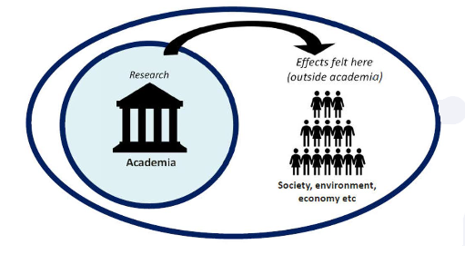
What is Research Impact?
Any provable Effect (Benefits ) of Research in
Real World is called impact.

Slide 15
Pathways to Research Impact

Slide 16
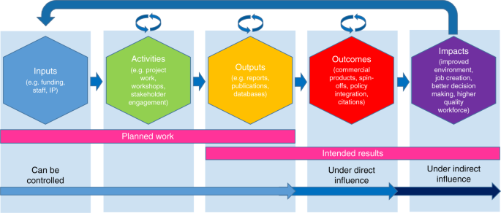
Assessment of Research Impact

Slide 17
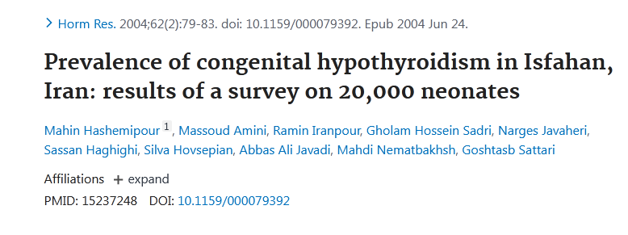
A real case of Research Impact

Slide 18
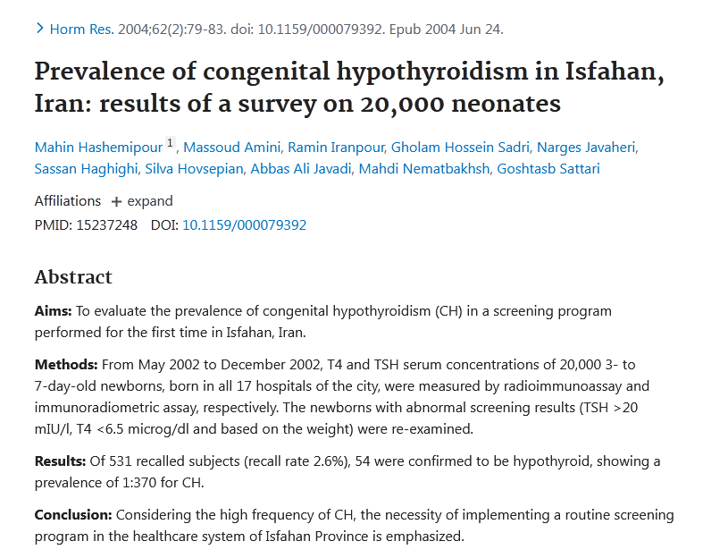
output

Slide 19
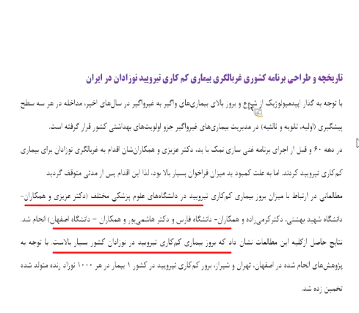
outcome

Slide 20
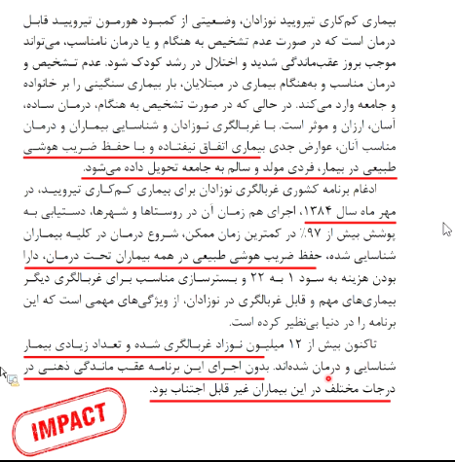

Slide 21
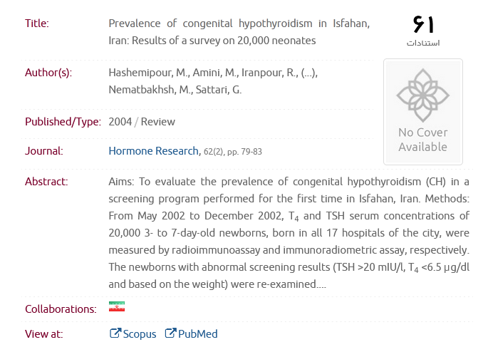

Slide 22
استناد (citation) همیشه نماد Impact نیست.
یک مقاله میتواند زیاد استناد نگرفته باشد ولی اثر بخش باشد. (یک مقاله
میتواند Research Impact به مفهوم citation نداشته، ولی اثرگذار باشد)
Social impact, Economic impact, social impact, …..

Slide 23
Research funders and research organizations
globally are looking to measure impact.

Slide 24
Steps in scientific writing
Design well
Decide politics
Choose journal
Read instructions to authors/papers
Prepare drafts
Submit
Good design Good impact

Slide 25
Different types of Research Impact
Social impact
Clinical impact
Economic impact
Impact on health and wellbeing
Environmental impact
Policy influence and change
Technological developments

Slide 26
How Research Impact is measured?
What are the resources for assessing impact?
How to improve our research impact?

Slide 27
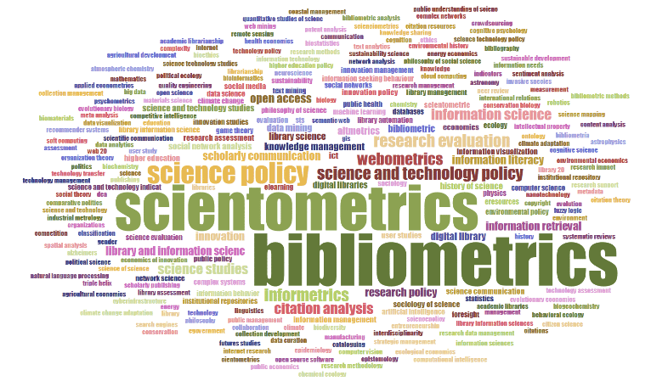

Slide 28
ارزیابی اثربخشی پژوهش

Slide 29
Altmetrics (Alternative Metrics)
Article Level Metrics

Slide 30
Attention score (252 , 37 , 115 , …)

Slide 31
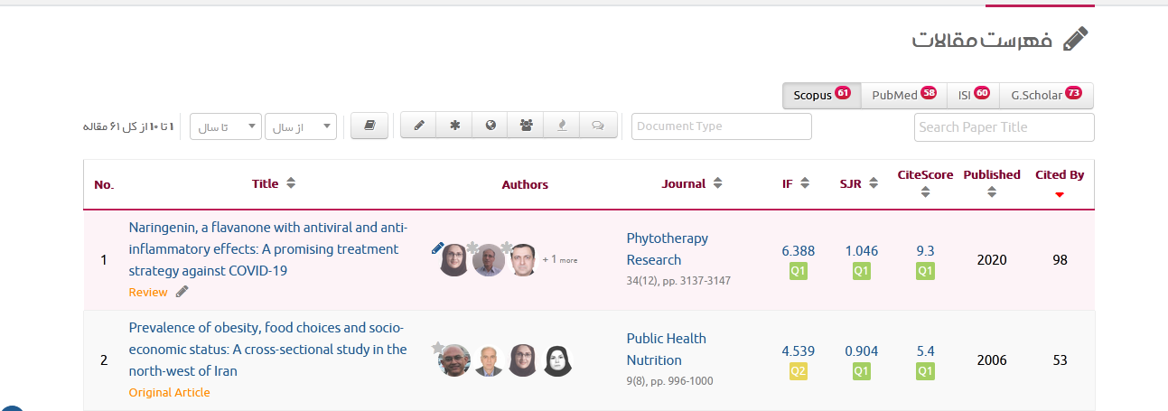
سامانه علم سنجی

Slide 32
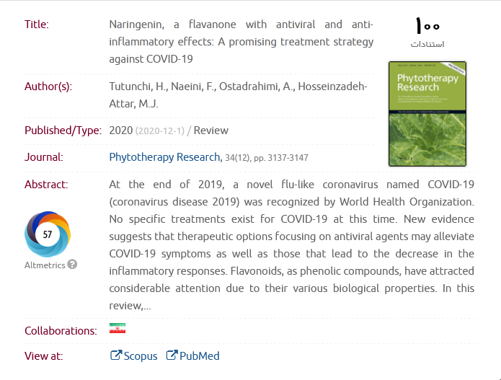

Slide 33
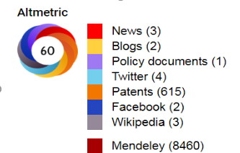
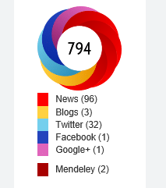
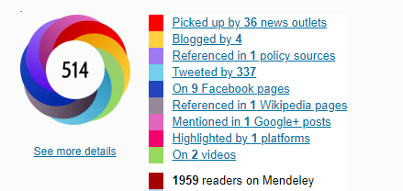

Slide 34
Citationو Altmetrics الزاما Impact نیستند، بلکه نمادی از Impactمیباشند.

Slide 35
How to improve Research Impact?
Research Impact and Visibility:
Pre-publication phase visibility
2) Post-publication phase visibility

Slide 36
Publication process
1) Preparing your article
2) Publishing your article
3) Promoting your published article
4) Monitoring your article

Slide 37
Publication process
Pre-publication
Preparing your article
Publishing your article
Post-publication
Promoting your published article
Monitoring your article

Slide 38
Pre-publication
Select research topics with a high potential academic
and/or societal relevance.
Consider the related Hot Topics
Don't forget that a good topic will result in a good impact.

Slide 39
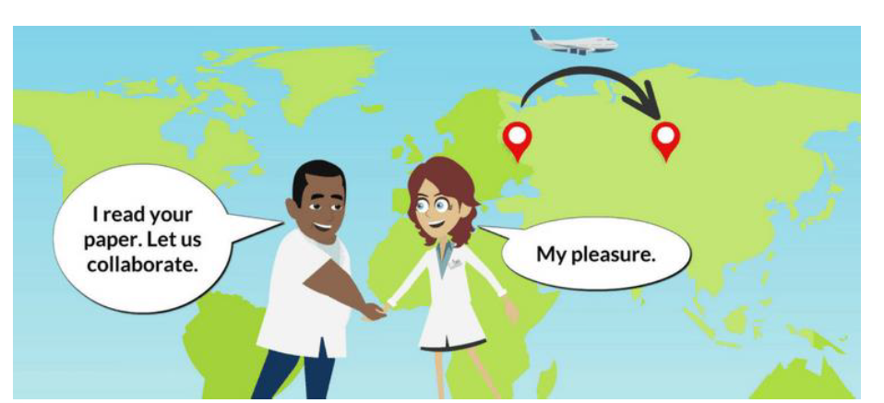
Pre-publication
Institutional, National & International Collaboration

Slide 40
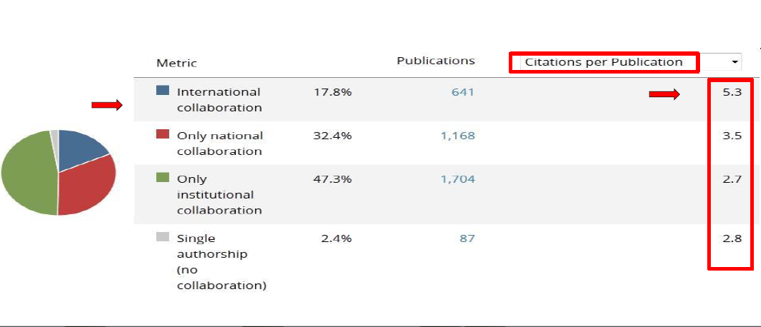
How collaborations increase research impact?
Positive effect on the number of citations

Slide 41
Preparing your article
Spend time on abstract and introduction & conclusion.
Increase impact of research with easy-to-understand graphs and
professional illustrations.
Use clear and correct manuscript language.
Consider brevity and clarity in paper, conciseness and precision in title.

Slide 42
Preparing your article
Ensure your research output has a clear title that is direct
interesting, concise, precise, and unique. This will promote
readership and attract citations from beyond your own discipline.
Think about writing a plain language summary of your research
that is understandable to a non specialist audience including public
or researchers from other disciplines.

Slide 43
Preparing your article
Enrich your article to present your research in the best possible ways:
Search Engine Optimization (keywords, Captions, Highlights)
Graphical Abstract
Using Multimedia (Editorial Podcasts, Audio Slides)

Slide 44
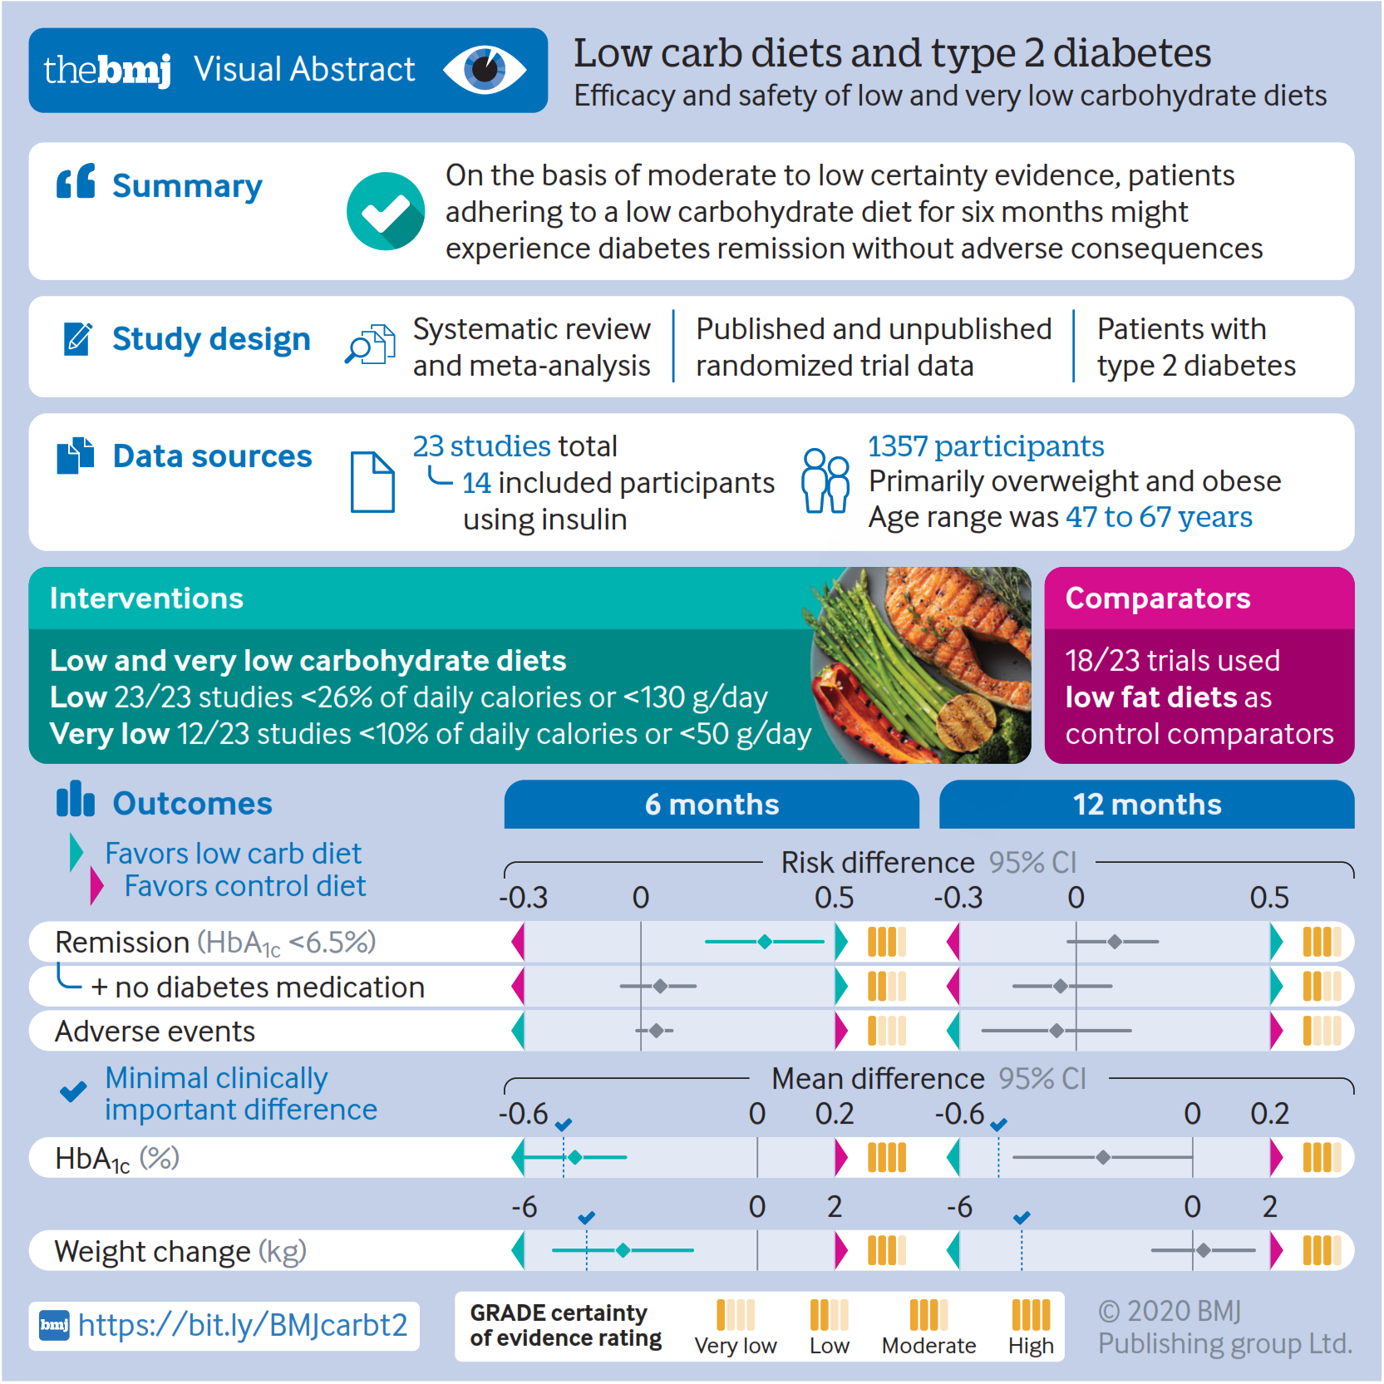
Preparing your article

Slide 45
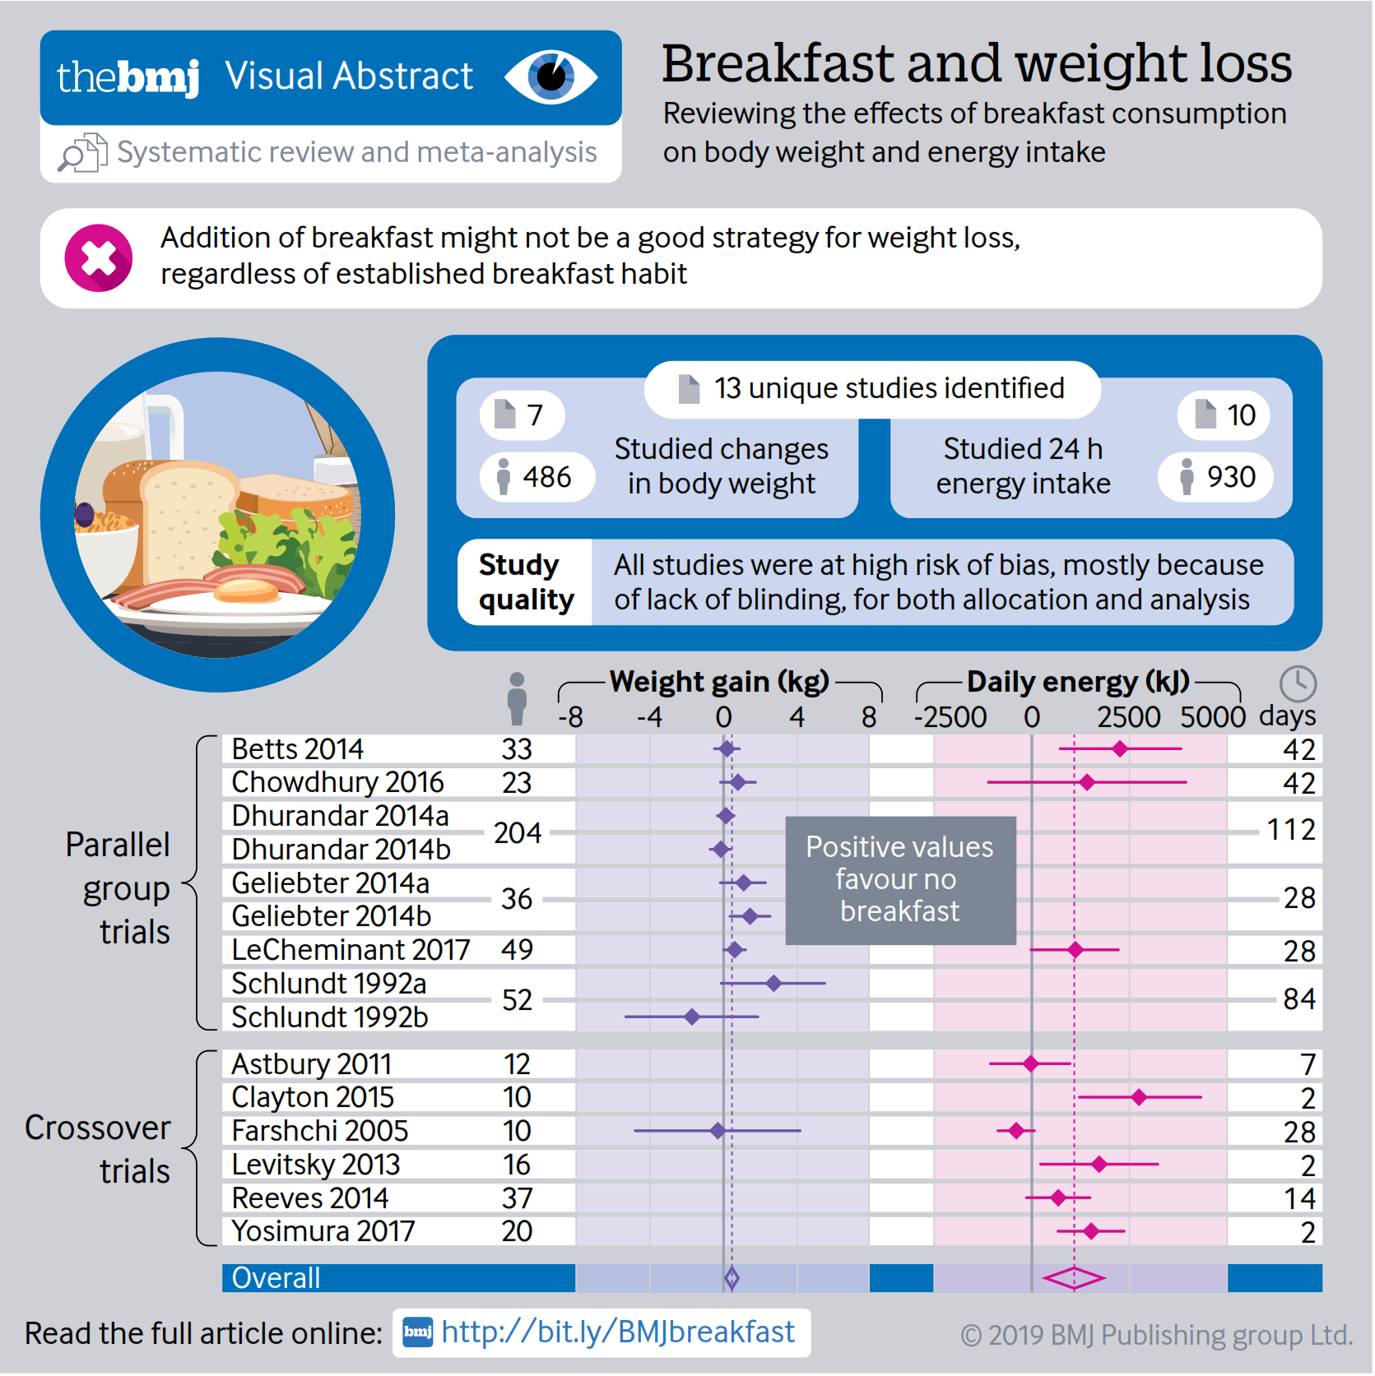
Preparing your article

Slide 46
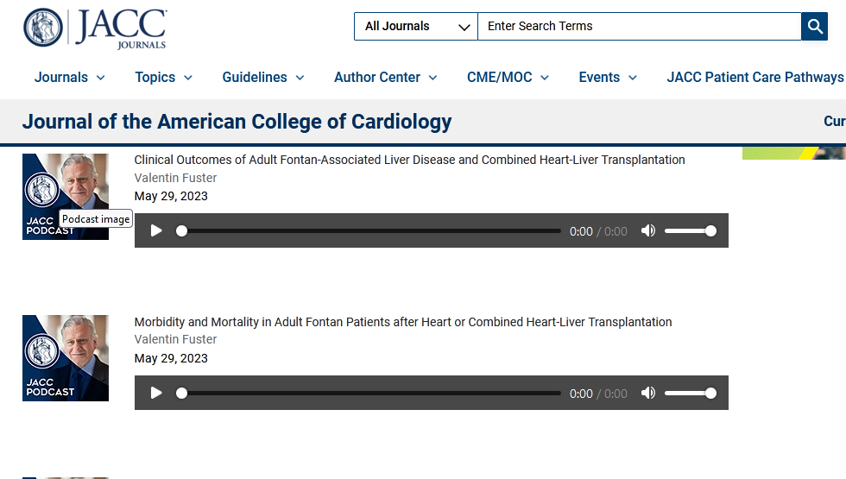
Preparing your article

Slide 47
Preparing your article

Slide 48
Publishing your article
Choose Right Journal to publish your manuscript.
Consider Open Access Journals.
Consider the indexing databases of target journal.

Slide 49
Considerations in selecting a journal
1. National or international audience?
2. Language?
3. Databases indexes Journal?
4. Multidisciplinary or specialty journals?
5. The journals content area/scope?
6.Chances of acceptance?
7. What about the impact factor?
8. Practical matters (time to publication, etc.)

Slide 50
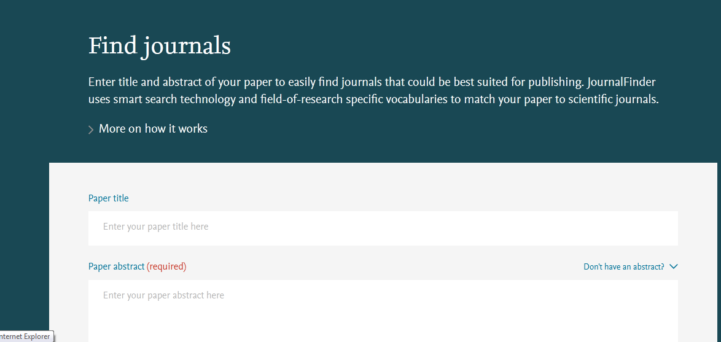
Elsevier Journal Finder
https://journalfinder.elsevier.com/

Slide 51
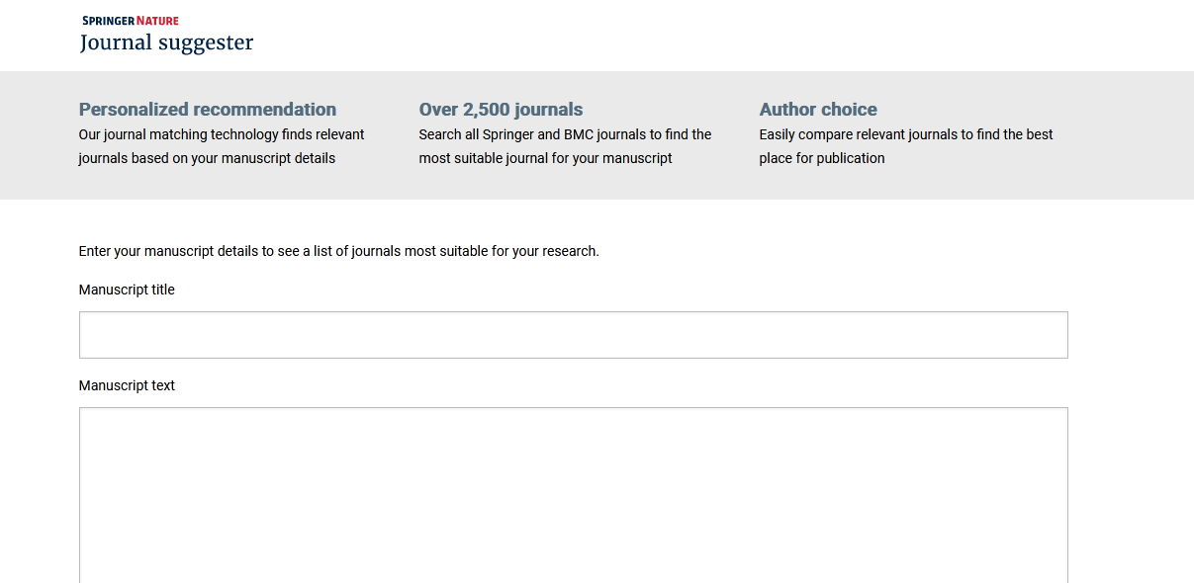
Springer journal suggester
https://journalsuggester.springer.com/

Slide 52
Journal Guide
https://www.journalguide.com/

Slide 53
What are the benefits of preprints?
Research impact
The research presented in preprint will be publicly available for other
researchers to cite and build upon more quickly.

Slide 54
Promoting and monitoring your published article

Slide 55
Post-publication
Writing and publishing your scholarly article is not the
final step. You must market your research.
To maximize your research impact, you must inform
everyone in your academic and social networks about it.

Slide 56
Post-publication
“Examples of Social Networks”

Slide 57
Post-publication
Increasing visibility and enhancing impact of research
The more visible you are, the more probable you make an impact

Slide 58
Post-publication
Make & mind your academic profiles
Use & update author identifiers and profiles:
ORCiD (Open Researcher and Contributor ID)
Google Scholar
ResearcherID
Publons
Scopus Author ID

Slide 59
Post-publication
Share links to your abstract or publication on
Academia , LinkedIn , on your website , your academic
institutions profile page, Facebook , Twitter , etc.
When publisher policy permits, post your article/study to:
ResearchGate , Academia, Mendeley and elsewhere.

Slide 60
Post-publication
Monitoring your article
Publishers Research Dashboard
Altmetric Indices
Social Networks
Scientometric Tools

Slide 61
Integrative approaches

